Slide 1
For ASE17

Slide 2
CYBERSECURITY SUMMIT
Federal Cybersecurity
Expert
National Intelligence Head
Policy
Negotiators
Social Media CEO
Global Tech CEO
Investigative
Cybersecurity
Journalist
Constitutional Rights Advocate
Notes:
ML
<number>

Slide 3
Caucus Table – 1 for each role
Caucus
Notes:
ML
<number>

Slide 4
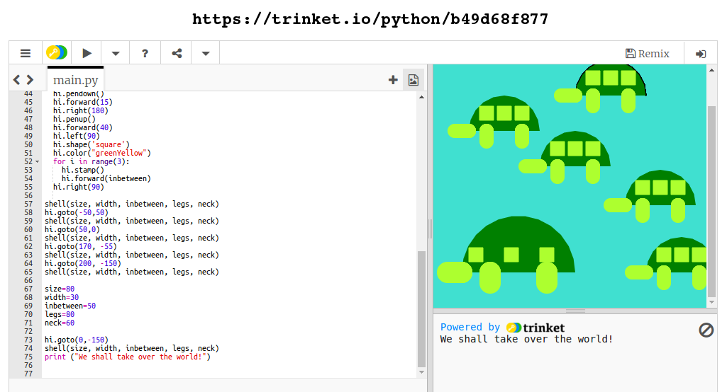

Slide 5
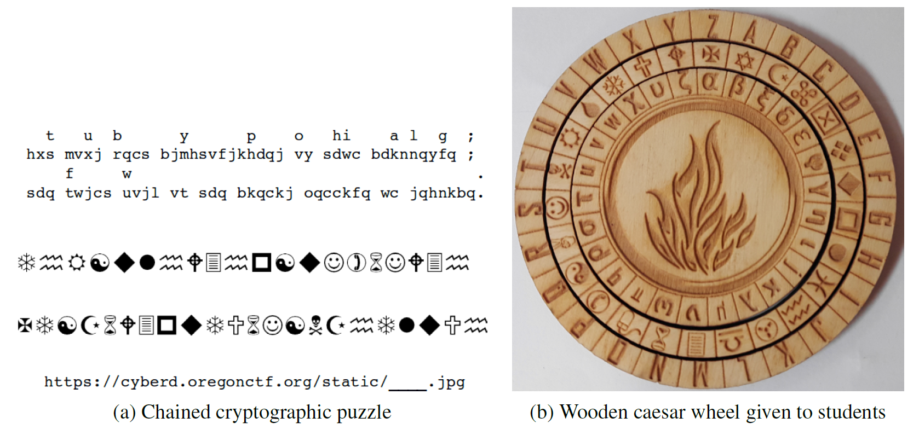

Slide 6



